Slide 1

Machine-Learning based variable compactability set-point control solution for improved casting outcomes
Deepak Chowdhary, Director & CEO
MPM Infosoft Pvt. Ltd., India
Inventor of Software

Slide 2
Definitions of various Compactability points in a foundry
Compactability is the percentage of compressibility of the moulding sand under impact of a predetermined weight (3 ram) or simultaneous jolt squeeze (cone jolt) pressure under laboratory test standards and conditions.
For the purposes of this presentation as well as keeping with general foundry Lexicon, this will be referred to as ‘Lab Compactability (LaCo)’.
The Compactability measured at the discharge of the mixer will be referred as ‘Discharge Compactability (DiCo)’
The Compactability setting set at the mixer’s Compactability controller to achieve the target LaCo will be referred as the ’Compactability Set Point (CoSP)’
Variable Compactability Set-Point algorithm/method is referred as ‘Vcomp-SP’

Slide 3
Importance of Compactability Control in foundries
One of the critical control levers for good casting outcomes is the control of moisture. Moisture being directly proportional to Compactability, the control of the Compactability assumes significant importance in the sand preparation process.
Other Compactability related casting outcome challenges include mould dilation and GCS control.
The key to good Compactability control is the set-point at the mixer which determines the discharge Compactability (DiCo) and ultimately, the Lab Compactability (LaCo).
Since The Lab Compactability (LaCo) depends upon the set-point at the Compactibility Controller the importance of determining the most optimal set-point at the Controller cannot be overstated.
Since the green sand ecosystem is in a state of perpetual dynamism, it stands to reason and logic that the system sand and its multifaceted control systems should also be pro-actively controlled, dynamically.

Slide 4
Present Approach to Compactability Set-Point (CoSP) settings
In the absence of analytics-driven decision support, the Compactability set point (CoSP) at the controller is experientially decided by the process manager based on an estimate of delta to the target LaCo.
More often than not, Compactability is also tweaked to adjust moisture in the sand.
The moulding sand however is subject to several influencing variables such as Ambient conditions, Return Sand properties, dynamic additives inflow and GFN, and other variables.
Therefore, when the sand is subject to dynamically varying influencing parameters, the Compactability setting should also be dynamic. Most often it is constant over time-periods. This explains the often high variance in the delta between the CoSP and the LaCo, specially in jobbing foundries.
The purpose of this research is to predict the CoSP dynamically using IIoT based data-analytics such that the target LaCo is achieved within minimum variance.

Slide 5
Dynamic, ML based compactability settings – some concept clarifications
“VComp-SP” is not intended as a replacement of the compactability controller.
The compactability controller is fundamentally tasked with translating the CoSP ( Compactability Set-Point) with as little variance as possible to the DiCo (discharge compactability).
The CoSP in general foundry operating conditions is set experientially by the process owner.
“VComp-SP” however models all the real time data sets that it receives from the IoT devices and sensors and sets the CoSP dynamically. This is the major USP of the invention.
This ML based dynamic set-point determination takes away the guesstimates from the process and makes it precise and responsive to the changing ambient and process conditions as explained later the accompanying case study.
This reduces the variance at the LaCo (Lab compactability) to as low as +/- 1.5 and 2.0

Slide 6
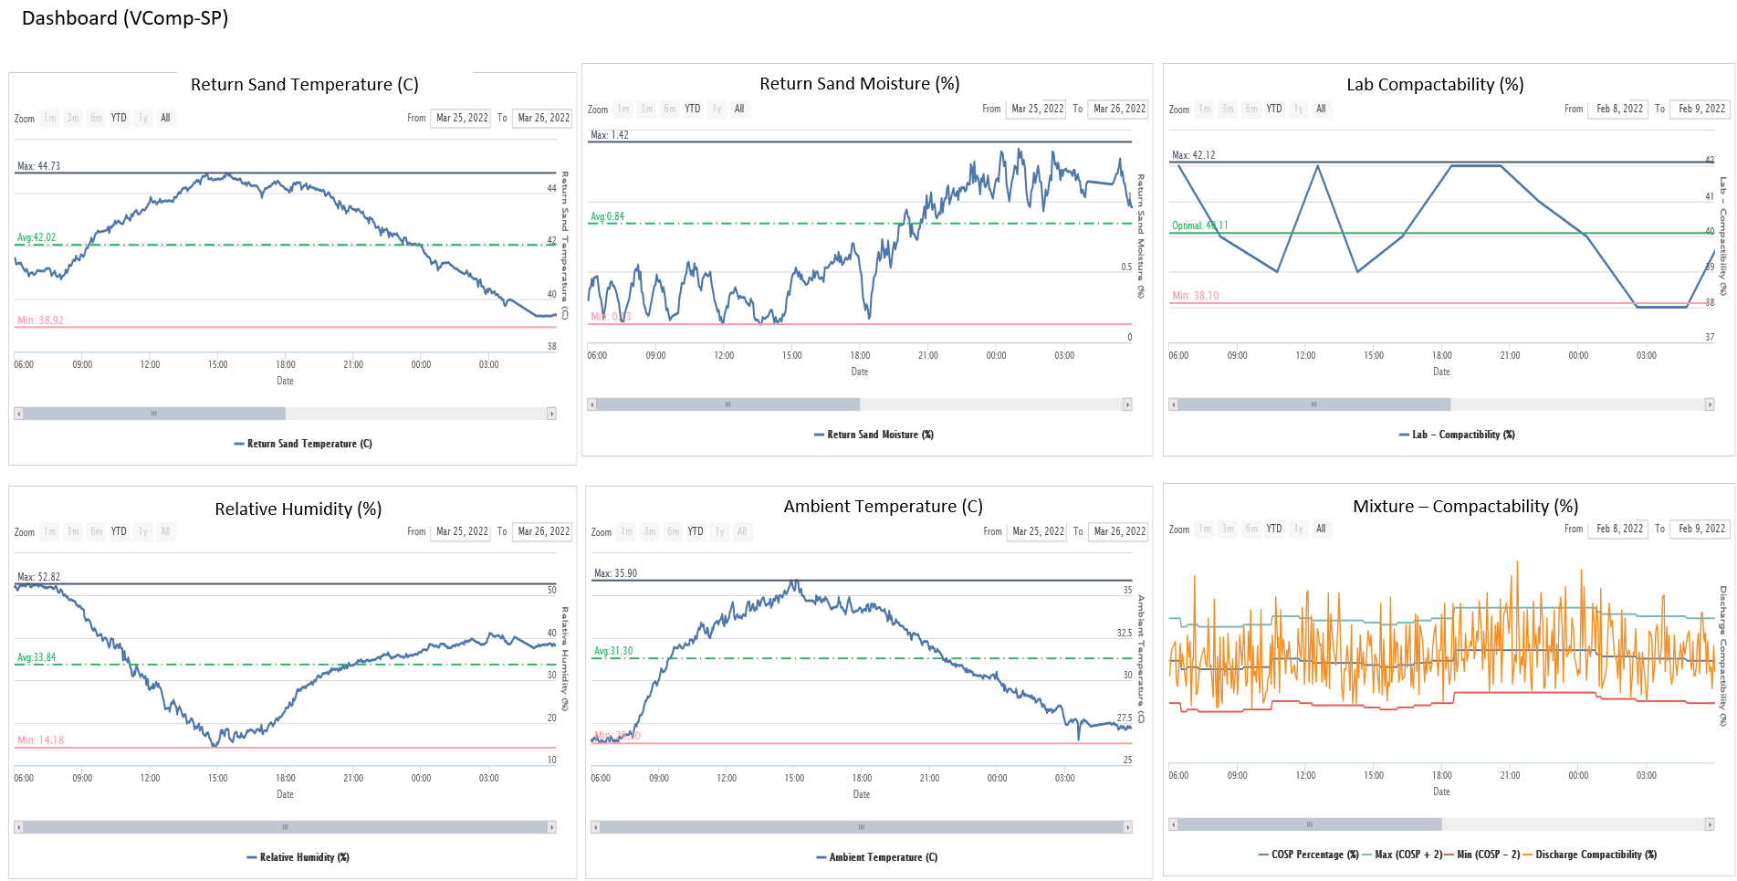
Different degrees of variability in sand & ambient parameters
Return Sand Moisture(%) varies from 0.73 to 1.42 in a particular day ,whereas Ambient Temp (C) varies from 25-36 and
Relative Humidity (%) varies from 14-53 etc.

Slide 7
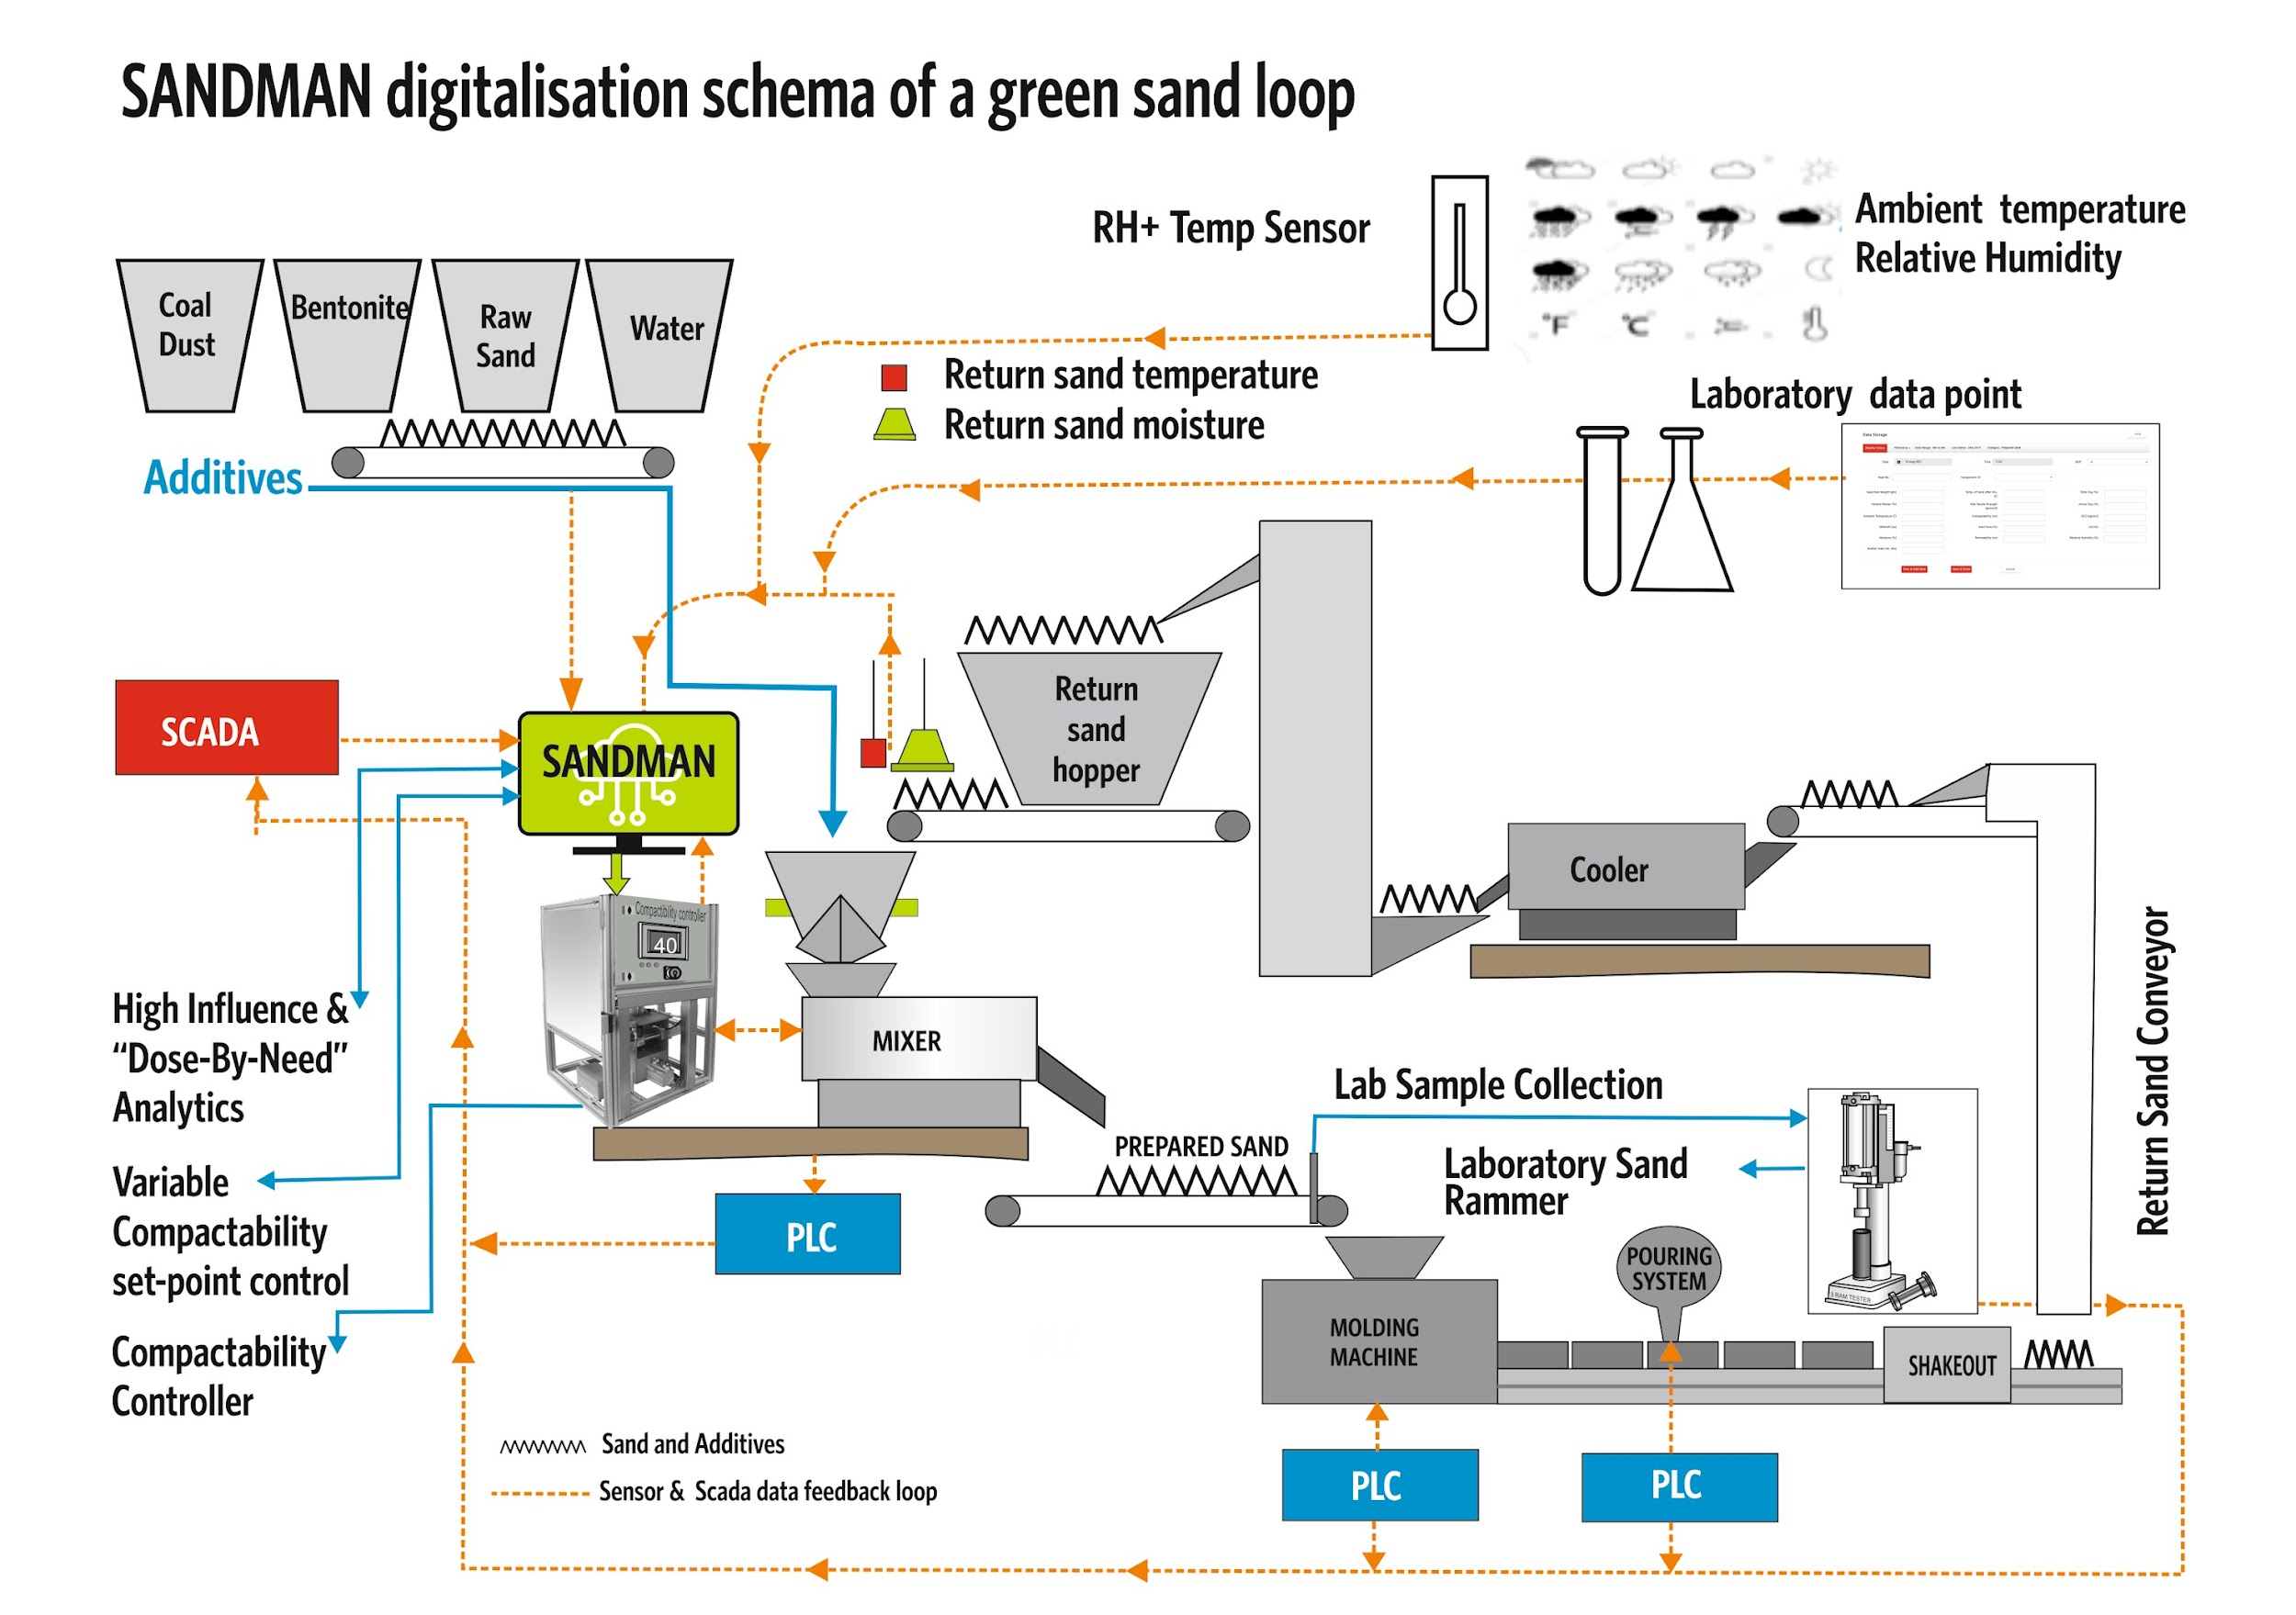

Slide 8
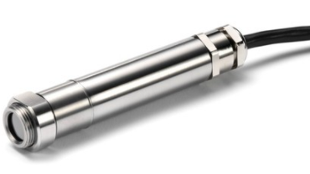
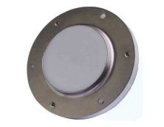




Process Optimization by Integrated Digitalization of data for higher integrity Moulds, more precise Casting outcomes
Smart Sensors
  Enables to collect real time data for process properties in digital format – Example: Return Sand Moisture & Temperature & Humidity sensors.
Internet of Things
  Enables real time exchange of data between– Molding Line ,Mixer SCADA, ERP,SAP and Compactability Controller Integration.
Elements of Industry 4.0 –
Applied in VCSP
Cloud Computing
  Centralized data storage, anywhere accessibility by Internet, cloud server-based programming and computing application.
Data Analytics
  Analysis of data and optimization of process using Advanced Machine Learning Algorithms and virtual AI.

Slide 9
Challenges in Optimization of Green sand system using Data Analytics
Challenges
Solution
Absence of meaningful and authentic data
Availability of Accurate, authenticated and Validated data at right time using real time data derived from IIoT’s.
Different types of data available at irregular intervals
Establishing data to be aligned using domain Knowledge
Challenge in maintaining the Testing Equipment's and Machines at consistent accuracy
Calibration of Equipment's periodically
Selection of right Approach
To Research and apply analytics Approach which should be problem specific.
The data presented in the case study is from a foundry using the VCSP system. The challenges were overcome by careful and diligent validation, alignment using time intervals of irregularly available data.

Slide 10
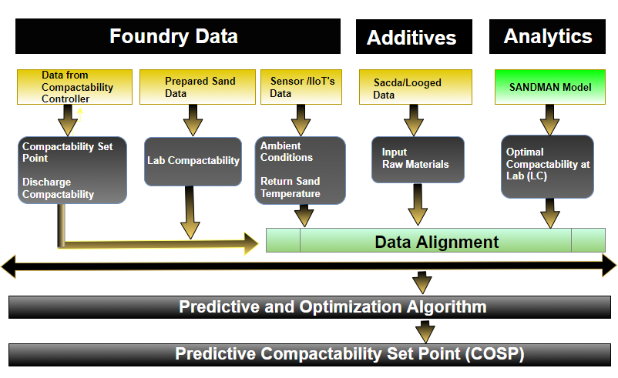
Variable Compactability Set Point(VCSP)
Methodology for Optimization of Lab Compactability

Slide 11
Case Study – Pre and post VCSP implementation
A = Baseline Data Period for comparing the VCSP performance Period: 3rd October 2019 to 11th February 2020
B = Data Period for Analysing the VCSP performance after Implementation Period: 13th February 2020 to 5th October 2020
In period B Set point is Fluctuating compared to A which indicates VCSP is dynamic (i.e. The VCSP is predicting a dynamic value based on the input parameters).

Slide 12
Case Study – Pre and post VCSP implementation
A = Baseline Data Period for comparing the VCSP performance Period: 3rd October 2019 to 11th February 2020
B = Data Period for Analysing the VCSP performance after Implementation Period: 13th February 2020 to 5th October 2020
Malfunctioning of
return sand Moisture
VCSP Stabilization period
Optimal Lab Compactability(40)
In period B Lab Compactability is close to optimal Compactability compared to A
In period B the fluctuations in Lab Compactability are reduced compared to A
Chart Courtesy: SANDMAN

Slide 13
Case Study – Pre and post VCSP implementation
A = Baseline Data Period for comparing the VCSP performance Period: 3rd October 2019 to 11th February 2020
B = Data Period for Analysing the VCSP performance after Implementation Period: 13th February 2020 to 5th October 2020
Period | A | B
Total number of data points | 913 | 913
Number of data points with LaCo within 39 to 41 (40±1) | 353 | 498
Percentage of the time LaCo within 39 to 41 (40 ±1) | 38.7% | 54.5%
Number of data points with LaCo within 38 to 42 (40 ±2) | 572 | 716
Percentage of the time LaCo within 38 to 42 (40 ±2) | 62.7% | 78.4%
Number of data points with LaCo > OLC +4 | 92 | 35
Percentage of the time LaCo > OLC +4 | 10% | 4%
In period B Lab Compactability is close to optimal Compactability compared to A nearly by 20 % more
Note: Optimal Lab Compactability value =40

Slide 14
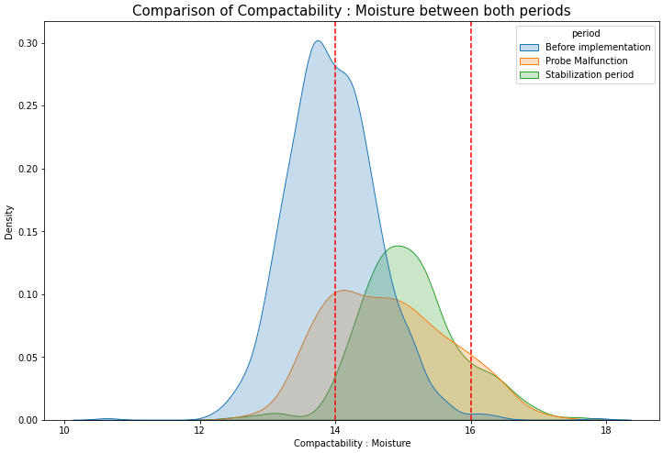
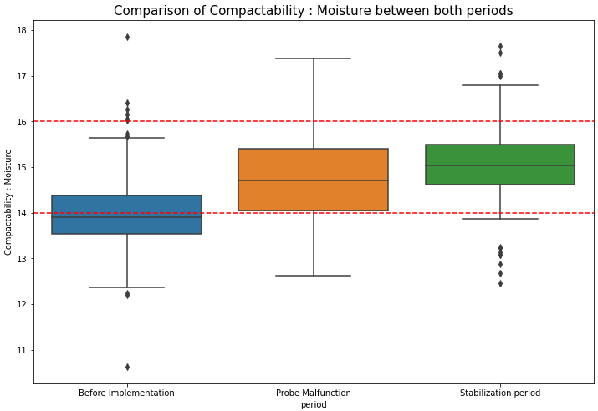
Compactability: Moisture ratio
Case Study – Pre and post VCSP implementation
Before Implementing VComp – SP : 3rd October 2019 to 11th February 2020
Probe Malfunction : July 2020
Stabilization period : 01st August 2020 to 5th October 2020
Observation: There is a distinct shift from the pre implementation period when we compare with post implementation period and especially in the stabilization phase. The data distribution in the stabilisation phase is tightly controlled within the foundry control limits.

Slide 15
Case Study - Effect of VCSP on Sand Parameters
A = Baseline Data Period for comparing the VCSP performance Period: 3rd October 2019 to 11th February 2020
B = Data Period for Analysing the VCSP performance after Implementation Period: 13th February 2020 to 5th October 2020
Standard Deviation of sand parameters for the two periods
Standard Deviation | Period A | Period B
GCS | 0.11 | 0.11
Compactability | 2.58 | 2.03
Active Clay | 0.20 | 0.20
WTS | 2.61 | 1.78
LOI | 0.17 | 0.13
Moisture | 0.14 | 0.13
Inert Fines | 0.21 | 0.23
Volatile Matter | 0.14 | 0.08
Permeability | 7.54 | 6.10
GFN/AFS | 0.27 | 0.21
Standard Deviation is reduced for most of the parameters in Period B compared to period A

Slide 16
Advantages and Limitations of Proposed Approach
Advantages
The Compactability Set-Point is dynamically variable
The Prediction of Compactability set point is based on the real-time or recent data
Reduces the variability in lab Compactability (LaCo)
Keeps the lab Compactability close to Optimal Compactability
Reduces incidence of sand related rejection.
It is possible to auto-set the CoSP.
Limitation
The Prediction of set point is dependent on sensor-based data

Slide 17
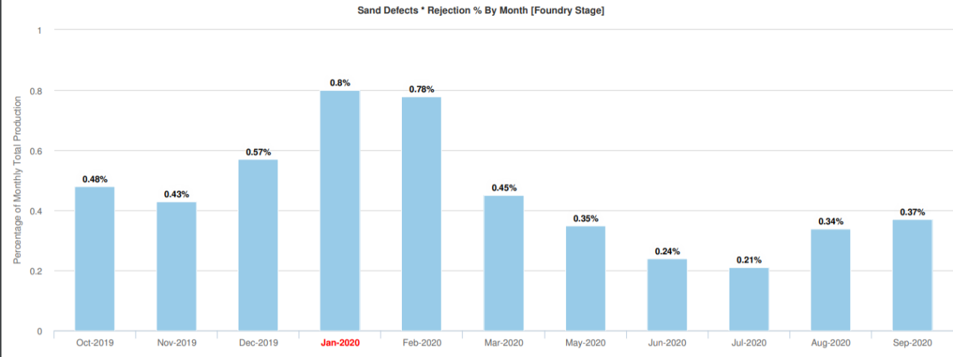
Case Study - Effect of VCSP on Sand related Rejection
A = Baseline Data Period for comparing the VCSP performance Period: 3rd October 2019 to 11th February 2020
B = Data Period for Analysing the VCSP performance after Implementation Period: 13th February 2020 to 5th October 2020
A
B
The sand related rejections at foundry stage has reduced in Period B (i.e. after implementing VCSP)

Slide 18
Benefits
•Out of 10 Components
5 Components have decrease in Casting Weight,
3 components have no change in weight,
2 components have increase in casting weight.
•Broken mould decreased from 0.03% to 0.002 %
•Shrinkage decreased from 0.49 % to 0.03 %
•Total Reduction in Rejection is 0.548 % - 254 MT. Period:
Disclaimer: The case study does not purport to claim these benefits solely on account of VComp – SP implementation. However, it is a fact that these changes to the casting performance were observed during the use of VComp-SP over the period when it was not in implementation.

Slide 19
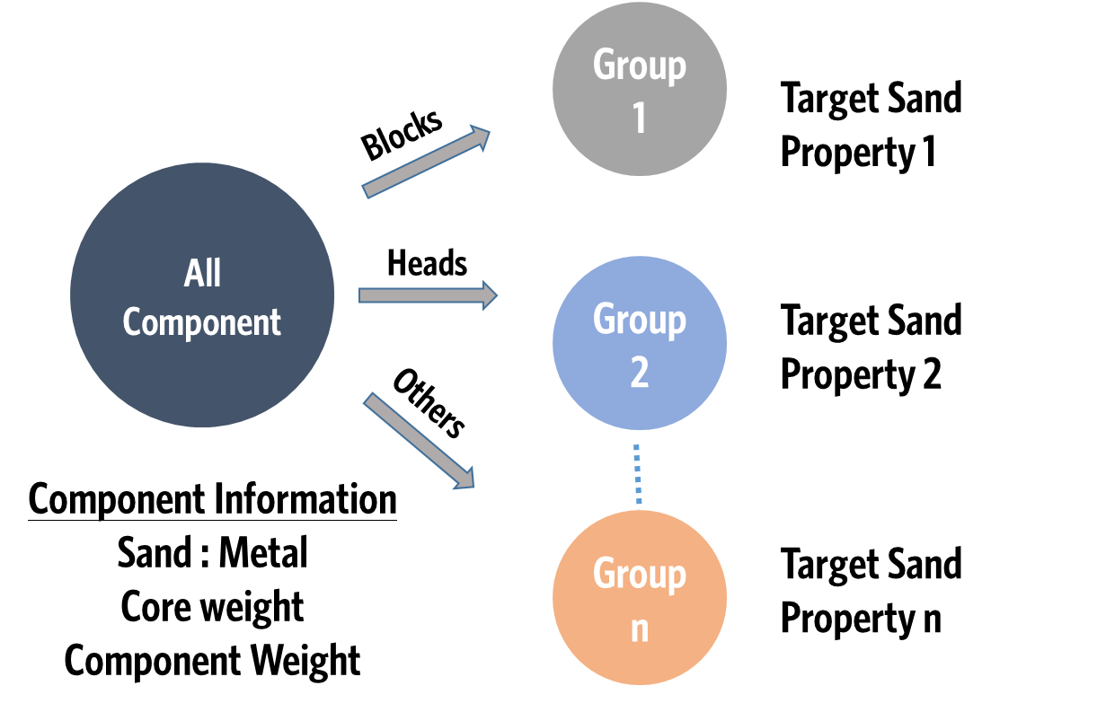
Enhancements in VCSP
Group Wise Set point
Casting based Sand Additive Requirement
Automated Grouping (e.g. S:M ratio) Algorithm
Group-1
Group -’n’
  VCSP Inputs –
  Group-wise Sand properties data , SMC data
  Group-wise Optimal Compactability
Group Wise Modelling
CoSP Group wise

Slide 20
CONCLUSION
The case study presented above demonstrates that the application of the proposed VCSP method has a clear and evident sensitivity of the lab Compactability to variation of the Compactability set-point at the mixer/controller based on input variables.
The case study clearly highlights reduced variation with increased consistency in lab compactability as reflected in its reduced standard deviation.
The reduction in the standard deviation of most of the sand parameters and more specifically in the Compactability, further strengthens the premise .
There is clear reduction in the sand related rejection which demonstrates that Compactability control has a clear impact on related sand rejection and therefore deserves increased importance in green sand foundries.

Slide 21

Literature on Green sand system Optimization & Data Analytics
Research on | Researchers / Year | Remark / Summary
Optimization of Parameters | S.Kumar,PS.Satsangi,et.al.,2011 | Optimization of Green Sand-Casting Process Parameters of a foundry by using Taguchi's method
Artificial Neural Networks and Genetic Algorithms | GL Datta, et. al., 2007 | Controlling of green sand mold properties using artificial neural networks and genetic algorithms
Data Analytics Driven Optimization | S.N.Ramrattan, et.al., 2016 | Predictive Analytics to Predict Highest Influencing sand properties impacting casting rejections
Optimization of Moulding Parameters | J. Bast, A.Kadauw, et. al., 2009 | Optimising of Moulding Parameters for Green Sand Compaction by Computer Simulation and a New Compaction Measuring Device
Taguchi DOE & Optimization | G. Patil, et. al., 2014 | Process properties are Optimized for minimizing Casting Rejections.
Genetic Algorithms and Machine Learning | D.E.Goldberg, et. al.,1989 | Genetic algorithm in search optimization and machine learning
Statistical Modelling | RR. Kundu, BN Lahari, et. Al.,2008 | Study and statistical modelling of green sand mold properties using RSM
No published research was found which determines how to achieve optimal Lab Compactability using Variable/Dynamic Compactability set point
Note

Slide 22

MPM INFOSOFT and the SANDMAN Team wish to thank “IIF and Distinguished members of the Foundry Industry” for the invaluable opportunity to present Variable Compactability Set-Point concept and method at the IFEX 2022”.

Slide 23
For additional information, please contact:
Deepak Chowdhary
MPM INFOSOFT PRIVATE LIMITED
✆ :+919890221100
Email : DEEPAK@MPMINFOSOFT.COM
Website : WWW.MPMINFOSOFT.COM

